Slide 1
Travel Info Relational Database for Search, Planning, and Recommendations
Group 15
Yushi She yshe7@gatech.edu
Zihao Zhao zzh628@gatech.edu
Yifan Zhao yifanzhao@gatech.edu
Tiffany Ma tma304@gatech.edu

Slide 2
agenda
Introduction
Technical Implementation
Project Outcomes
Reflection and Future Works

Slide 3
Introduction
A Travel Information Relational Database
Purpose: Centralized system for travel information retrieval and trip planning.
Target Audience: Travelers who plan ahead.
Project Status: Fully implemented database structure with sample data and basic front-end UI.
Notes:
This project centers on building a relational database tailored for travel planning. Its primary purpose is to consolidate fragmented travel information into a centralized system, enabling efficient retrieval and trip planning. The target audience includes travelers who like to plan ahead, looking for a streamlined tool to manage their trips.
The database structure has been fully implemented and populated with sample data to demonstrate functionality. Additionally, a simple front-end UI provides an accessible interface for querying and exploring the system."

Slide 4
Technical Implementation
ER diagram
Datasets
Technical stack
Challenges

Slide 5
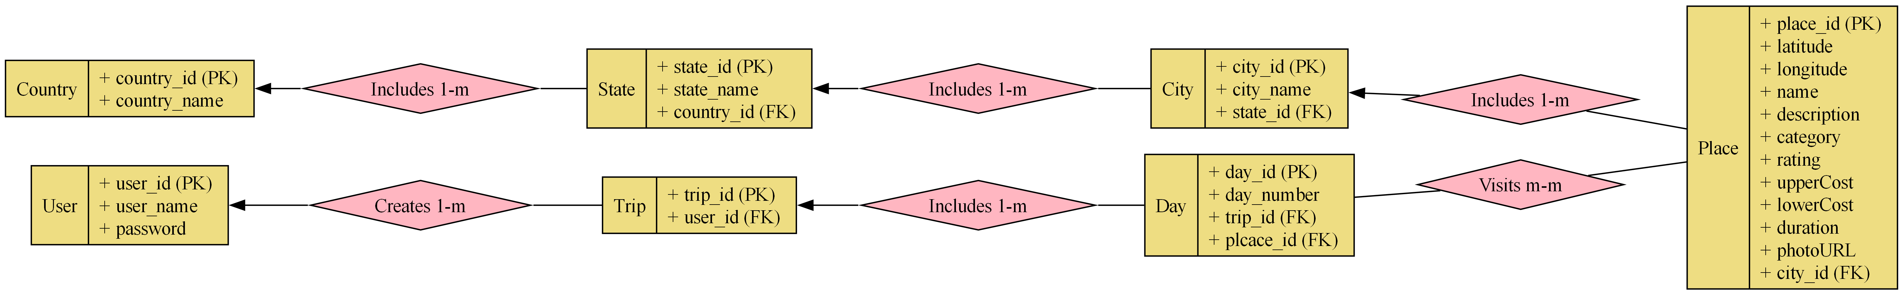
ER Diagram
Notes:
"This ER diagram illustrates the design of our travel information database, which organizes data into structured entities and relationships to support efficient interactions.
Core Entities:
Country, State, and City: These tables represent the hierarchical geographical structure. Each Country includes multiple States, and each State includes multiple Cities. This ensures a clear representation of location data.
Place: The Place table contains detailed information about points of interest, including attributes such as latitude, longitude, name, description, category (e.g., attractions, dining), rating, cost ranges, duration, and photo URLs. Each Place is associated with a specific City.
User and Trip Management:
User: The User table stores user information, including a unique ID, username, and password, ensuring secure and individualized access.
Trip: Each User can create multiple trips, as shown in the one-to-many relationship between User and Trip. Each trip serves as a collection of planned visits in the unit of days or in database language through the day table.
Day and Trip Itineraries:
Day: The Day table represents the individual days within a trip. Each trip can consist of multiple days, and the relationship is one-to-many.
Day-Place Relationship: Days have a many-to-many relationship with Places, enabling users to associate multiple places with each day and visit the same place on different days. To add or delete a place in to a trip plan is actually adding a or deleting a row from the Day table.
Key Relationships:
The Includes relationships between Country, State, and City ensure geographic data is consistently organized.
The Visits many-to-many relationship between Day and Place supports flexible itinerary planning.
The Creates one-to-many relationship between User and Trip establishes user ownership of trip data.

Slide 6
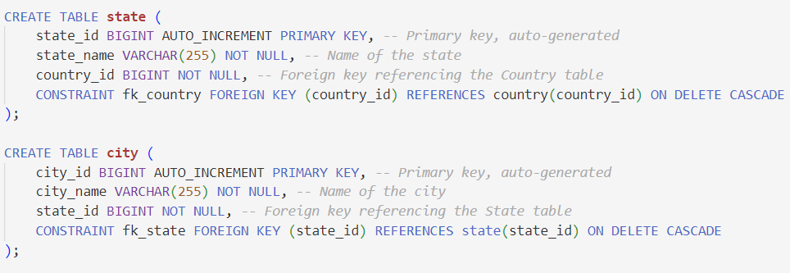
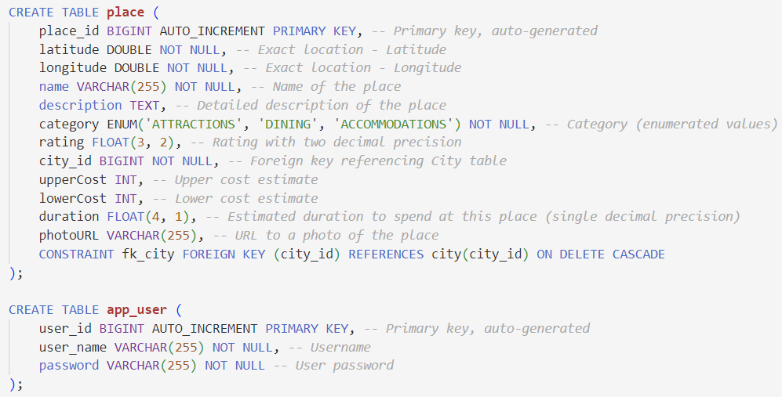
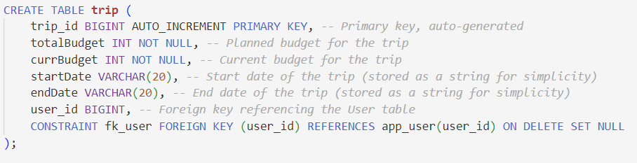
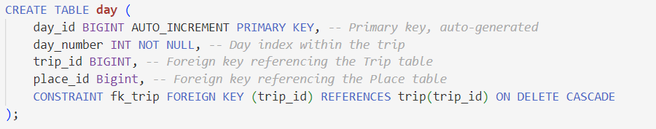
relational schema
Notes:
Relational Integrity:
Each table has a clearly defined primary key (e.g., place_id, user_id) to ensure unique identification of records.
Foreign keys, such as city_id in Place or trip_id in Day, enforce relationships and maintain data consistency.
This schema does not only support efficient data retrieval and storage but also lay foundation for complex queries for itinerary generation, personalized recommendations, and detailed exploration of travel options."

Slide 7
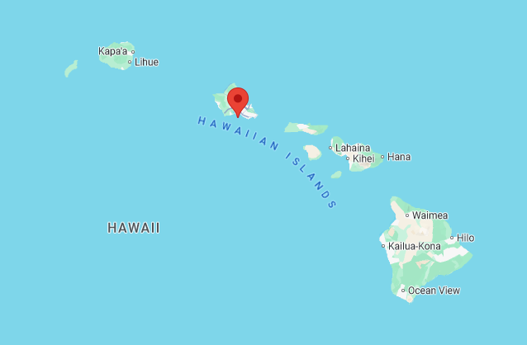
Datasets
Google Maps Places API
Centered on Hawaii
Tourist attractions, restaurants, and lodging
60 results scraped per category
Name, place_id, address, description, type, rating, price_level, latitude, longitude, city, state, country
21.289373, -157.917480
Notes:
To support our relational schema, we decided to create a dataset of locations in a popular tourist destination, the island state of Hawaii. Thankfully, we were able to leverage Google Maps' Places API to obtain all of the necessary information. Using this API, we scraped 60 results from each of three place types as tagged by Google: tourist attractions, restaurants, and lodging. Once a response was obtained from the API, the fields relevant to our relational schema were extracted and formatted into a single row added to our CSV. The columns were name, place ID, address, description, type, rating, price_level, latitude, longitude, city, state, and country.
While the dataset is relatively small, it is sufficient for our full demonstration of our system; a larger dataset can be obtained by requesting additional information from the API.

Slide 8
Technical stack
Android frontend
Spring Boot backend
MySQL database
Notes:
This tech stack architecture are outlined here:
The Android frontend provides an interactive interface for users to plan trips, set preferences, and explore recommendations.
The Spring Boot backend is the core processing unit, handling user requests, business logic, and API interactions.
The MySQL database is responsible for securely storing and retrieving data, supporting all trip-related workflows.
The system's modular design ensures scalability and ease of maintenance, with well-defined interactions between each layer."

Slide 9
Challenges
Designing an Efficient Data Structure:
The seemingly simple data structure required extensive discussion and iteration.
Focus was on aligning the design with database normalization and other principles learned in class to ensure scalability and efficiency.
Data Retrieval Efforts:
Collecting and integrating travel-related data from web sources proved time-consuming.
Google Maps API to retrieve Place data + a Github Countries States Cities Database
Frontend UI Development:
Creating a Android UI, while not the primary focus of the project, was time-intensive.
Focused on implementing essential features and some queries are only written in backend functionalities.
Notes:
Designing the data structure turned out to be more complicated than expected and took a lot of discussion and iteration. To solve this, we focused on following database normalization and other principles from class to make sure it would be scalable and efficient.
Gathering and integrating travel-related data from different web sources was pretty time-consuming. To solve this, we used the Google Maps API to get place data and a GitHub Countries States Cities database for location information.
Building the Android UI wasn’t the main focus of the project, but it still took a lot of time. To make it manageable, we focused on adding the essential features and moved some of the more complex queries to the backend.

Slide 10
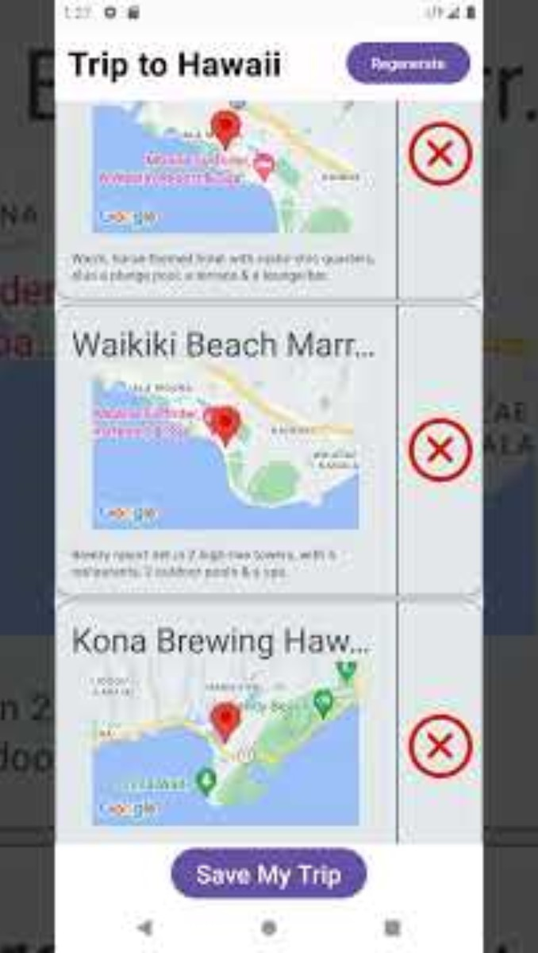
Project outcomes
Complete relational database with sample data
Interactive UI for CRUD operations
Advanced queries and backend logic will be showcased on demo day
Notes:
The main outcome of our project is quickly demo-ed here. The landing page of the application allows users to define the destination and duration of their trip. Each drop down menu queries the database and presents results to the next drop down menu. Once the trip has been created, the database is queried for places to automatically populate the itinerary for each day. These initial entries consist of one hotel, two restaurants, and four tourist attractions per day. At this stage, the user's trip has been added to the trip table in our relational schema. The user has the ability to alter this table further by manually deleting the generated entries, as well as adding entries themselves using the "Add location" button. The user can choose from the entire database to select and add places to their trip.

Slide 11
Reflection
Database Creation:
Designed and implemented a real-world applicable relational database from scratch, including schema design and integration with backend and frontend.
Application of Principles:
Successfully applied database design principles from class, to enable efficient relationship management and ensure scalability.
Notes:
As for the reflection, our project has provided valuable learning experiences.
First, we learned how to create a relational database from scratch and how to make it applicable to real-world scenarios.
And we also apply database design principles from our lectures and optimize our schema for better scalability.

Slide 12
Future Works
Advanced Recommendation Algorithms:
Develop more sophisticated algorithms beyond simple sorting by attributes to enhance personalized recommendations.
Indexing for Larger Datasets:
Implement indexing strategies to handle larger datasets efficiently and improve data retrieval performance for real-world applications.
Notes:
For the future works,
First, we want to develop more sophisticated algorithms beyond simple sorting in order to achieve personalized recommendations for travelers.
And we also want to implement indexing strategies to handle larger datasets efficiently and improve data retrieval performance for real-world applications.

Slide 13
Thank you
Group 15
Yushi She
Zihao Zhao
Yifan Zhao
Tiffany Ma

